Slide 1
Biological image analysis: from segmentation to database building

Slide 2
What is image segmentation and why it is important
Definition:
Image segmentation consists in partitioning an image into multiple regions that contain information. The goal is to reduce the complexity of an image in order to simplify the analysis
Types of segmentation:
Semantic Segmentation
Instance Segmentation
Use of Image Segmentation:
Medical Images
Autonomous systems
Geographical Image Analysis
…

Slide 3
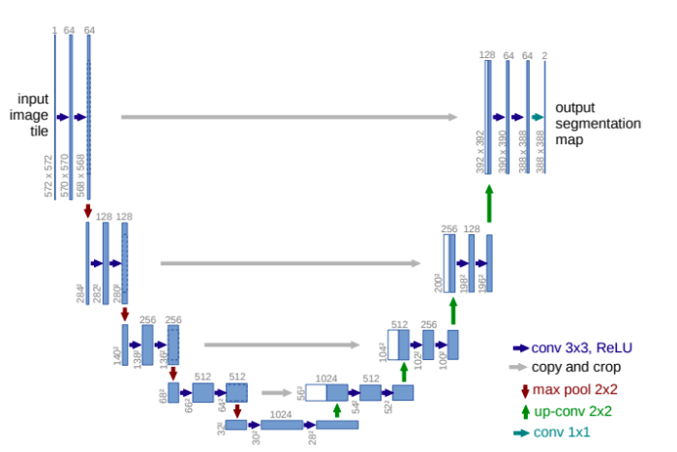
How to segment images: deep learning models
Architecture of the model:
CNN encompassing multiple Conv layers
combined with MaxPooling and concatenation
Example of existing model:
FCN
U-Net
ParseNet
FPN
Mask RCN
DeepLab
…
U-Net model for segmentation

Slide 4
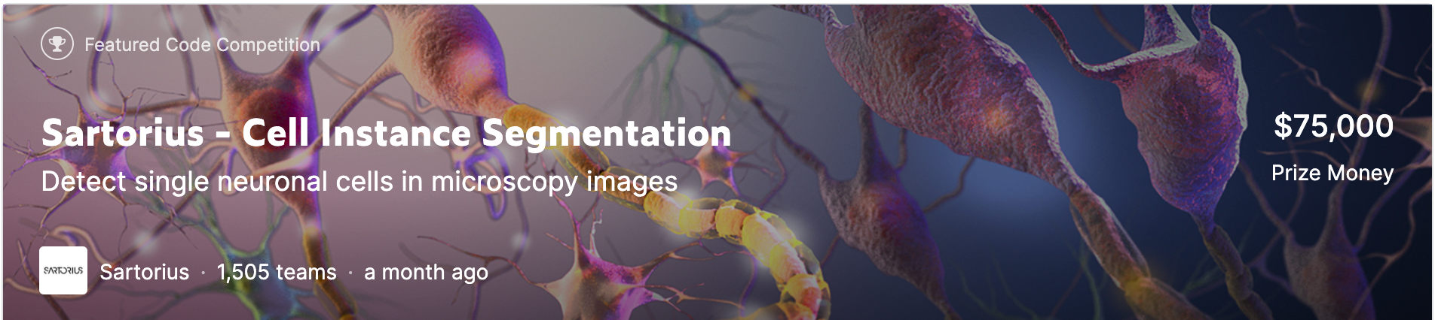
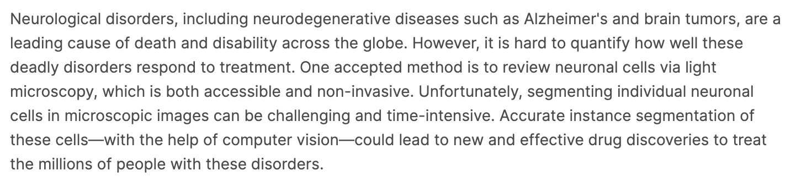
Cell Instance Segmentation
Detect single neuronal cells in microscopy images
A train folder containing img in .png format
A test folder containing 3 images to test the prediction (for submission)
A .csv file containing amongst other thing the rle of each cell as well as the cell type
An extra folder containing different cell type to try on
https://www.kaggle.com/c/sartorius-cell-instance-segmentation
Here the goal is to create masks around cells, not to classify them : Semantic Segmentation

Slide 5
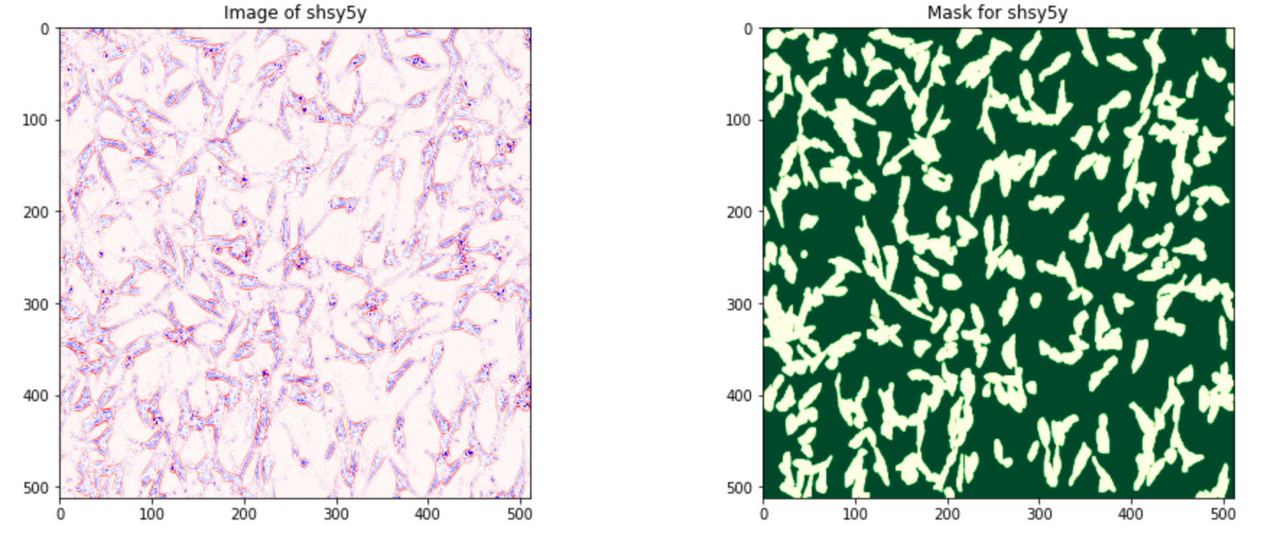
Data Exploration

Slide 6
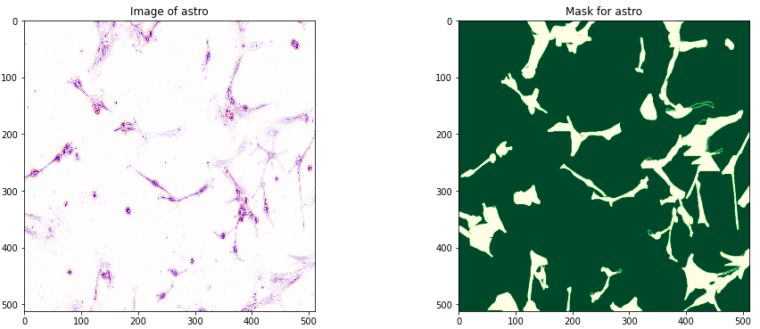
Data exploration

Slide 7
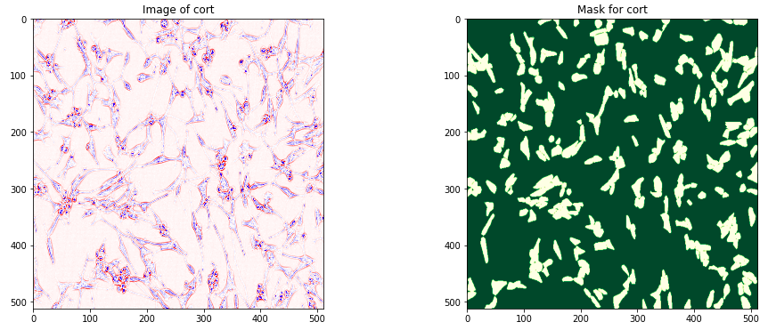
Data exploration

Slide 8
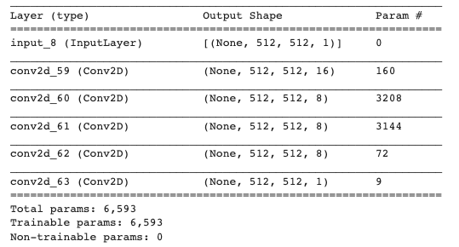
Model in action
Model 1:
Simple model composed of 5 convolutional layers
Augmentation of data (RandomTranslation, RandomZoom, RandomRotation, RandomFlip)
Model summary

Slide 9
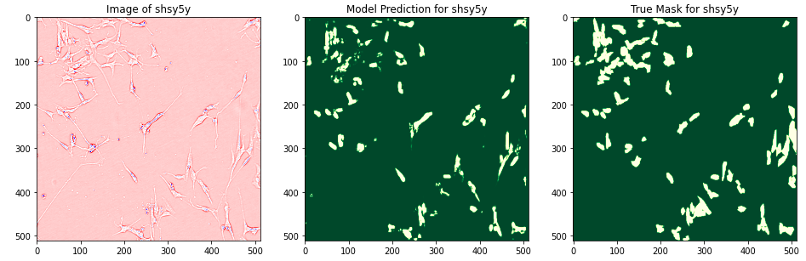
Models in action
Model 1:

Slide 10
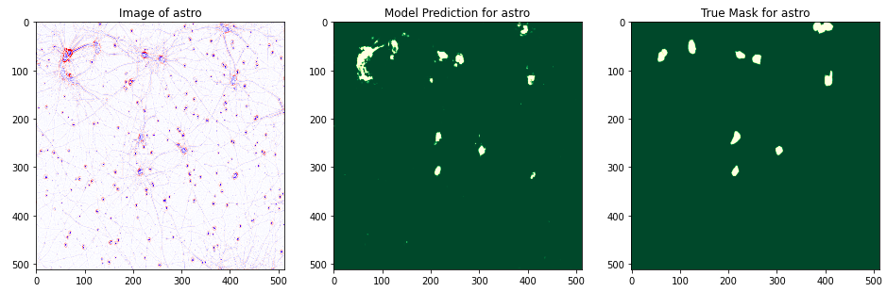
Models in action
Model 1:

Slide 11
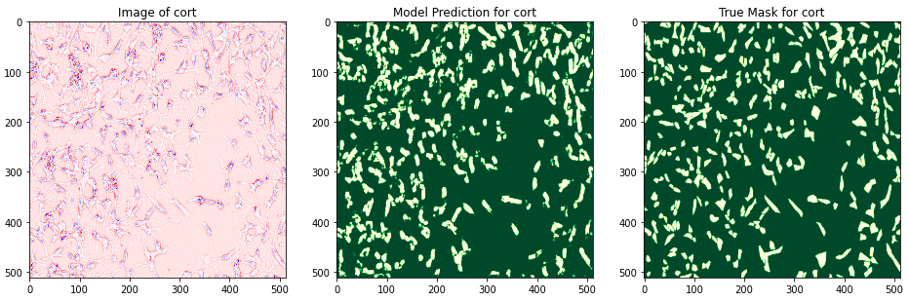
Models in action
Model 1:

Slide 12
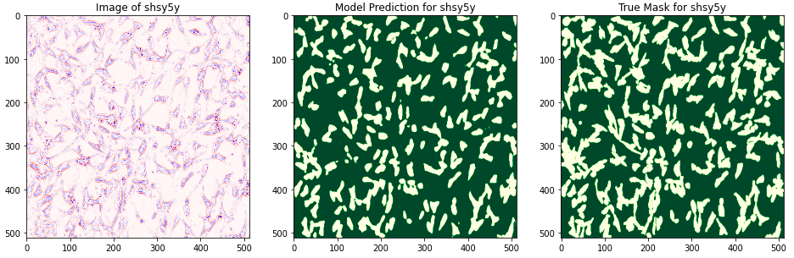
Models in action
Model 2:
Typical U-net model without augmentation (7,759,521 parameters)

Slide 13
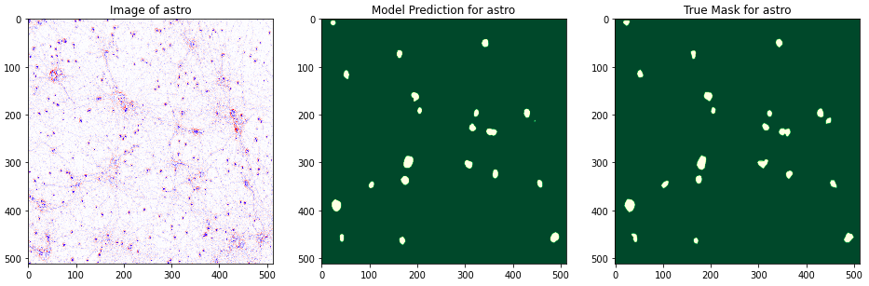
Models in action
Model 2:
Typical U-net model without augmentation (7,759,521 parameters)

Slide 14
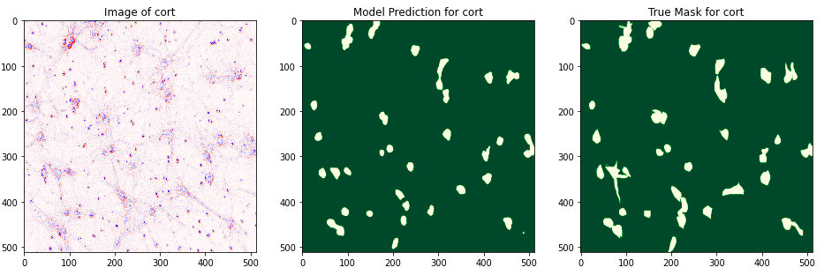
Models in action
Model 2:
Typical U-net model without augmentation (7,759,521 parameters)

Slide 15
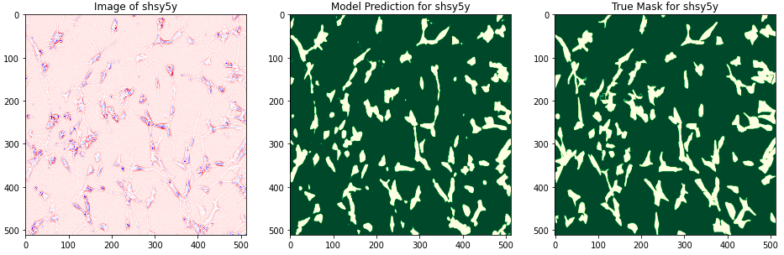
Models in action
Model 3:
Typical U-net model with augmentation (7,759,521 parameters)

Slide 16
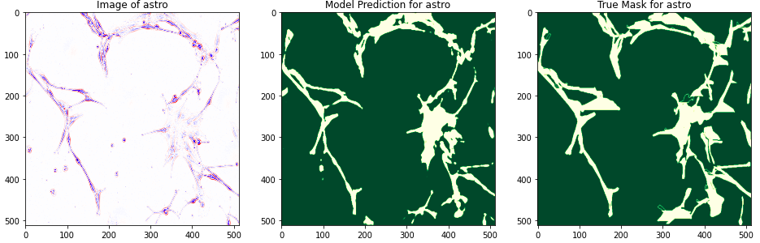
Models in action
Model 3:
Typical U-net model with augmentation (7,759,521 parameters)

Slide 17
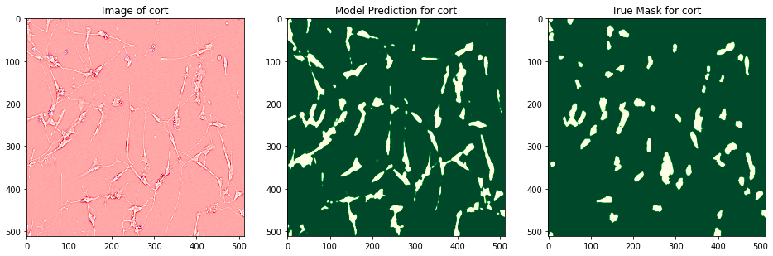
Models in action
Model 3:
Typical U-net model with augmentation (7,759,521 parameters)

Slide 18

Web-app deployment

Slide 19
Wrap-up
Tools used:
Data wrangling
Data visualisation
Computer vision
Database building
Things to add:
Combine with traditional ML (i.e KNN, SVM…)
Analyse some extra features (i.e computer area of cells and so on to perform deeper analysis
THANK YOU FOR YOUR ATTENTION!

